Slide 1
SciPy Overview
Available at www.scipy.org
Open Source BSD Style License
Over 30 svn “committers” to the project
CURRENT PACKAGES
Special Functions (scipy.special)
Signal Processing (scipy.signal)
Image Processing (scipy.ndimage)
Fourier Transforms (scipy.fftpack)
Optimization (scipy.optimize)
Numerical Integration (scipy.integrate)
Linear Algebra (scipy.linalg)
Input/Output (scipy.io)
Statistics (scipy.stats)
Fast Execution (scipy.weave)
Clustering Algorithms (scipy.cluster)
Sparse Matrices (scipy.sparse)
Interpolation (scipy.interpolate)
More (e.g. scipy.odr, scipy.maxentropy)

Slide 2
PyLab
Sometimes the union of the 5 packages is called pylab: ipython -pylab.
Literally 1000's more modules/packages for Python
PMV
PIL
IPython
MayaVi
VTK
SciPy
Matplotlib
DejaVu
RPy
NumPy
PMV
ETS
ViPEr
MolKit
Python
Pygame

Slide 3
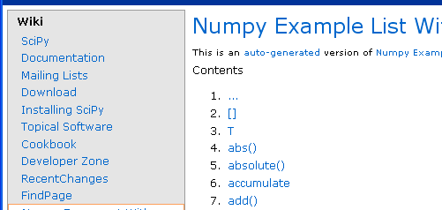
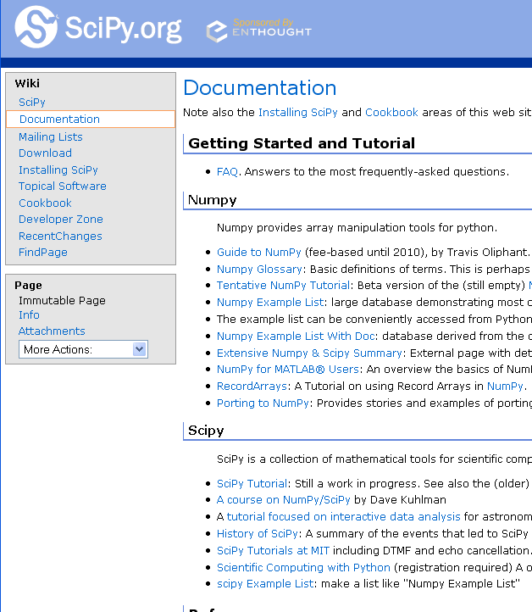
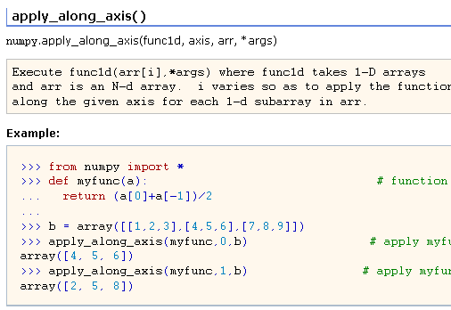
Helpful Sites
SCIPY DOCUMENTATION PAGE
NUMPY EXAMPLES
http://www.scipy.org/Documentation
http://www.scipy.org/Numpy_Example_List_With_Doc

Slide 4
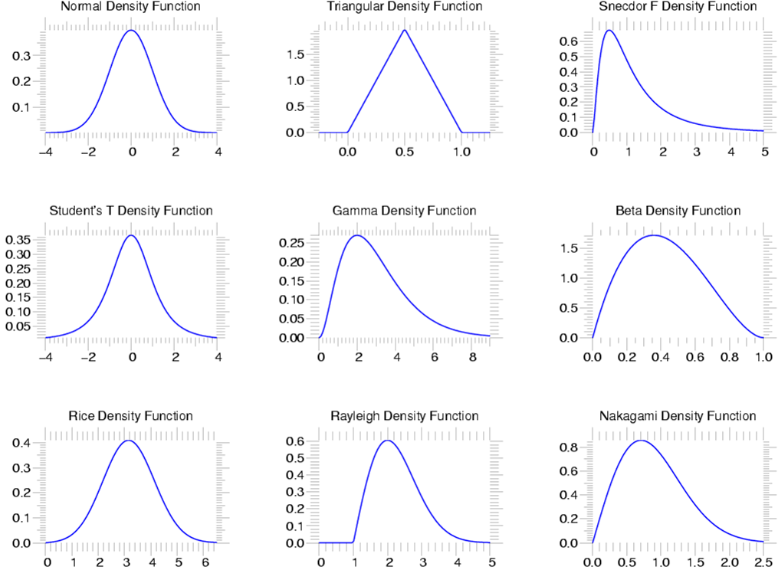
Statistics
scipy.stats --- CONTINUOUS DISTRIBUTIONS
over 80 continuous distributions!
METHODS
pdf
cdf
rvs
ppf
stats

Slide 5
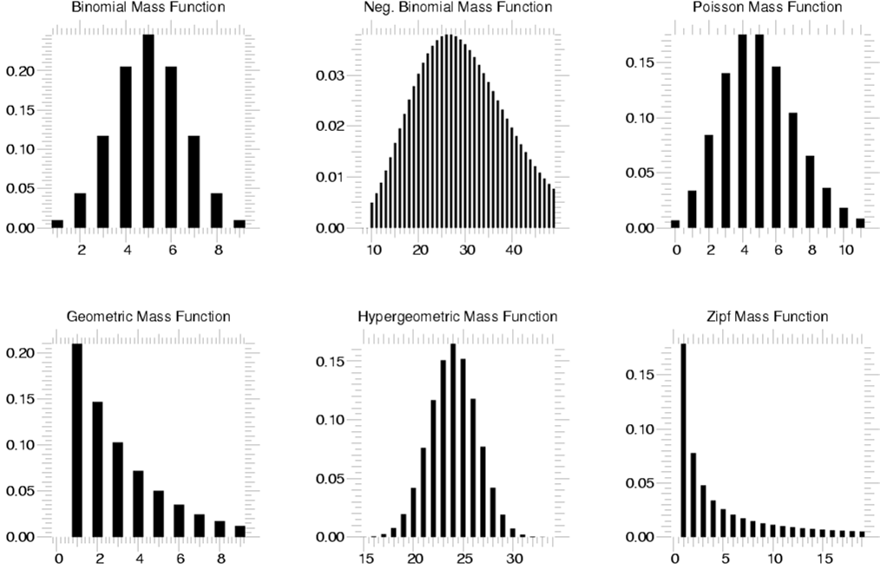
Statistics
scipy.stats --- Discrete Distributions
10 standard discrete distributions (plus any arbitrary finite RV)
METHODS
pdf
cdf
rvs
ppf
stats

Slide 6
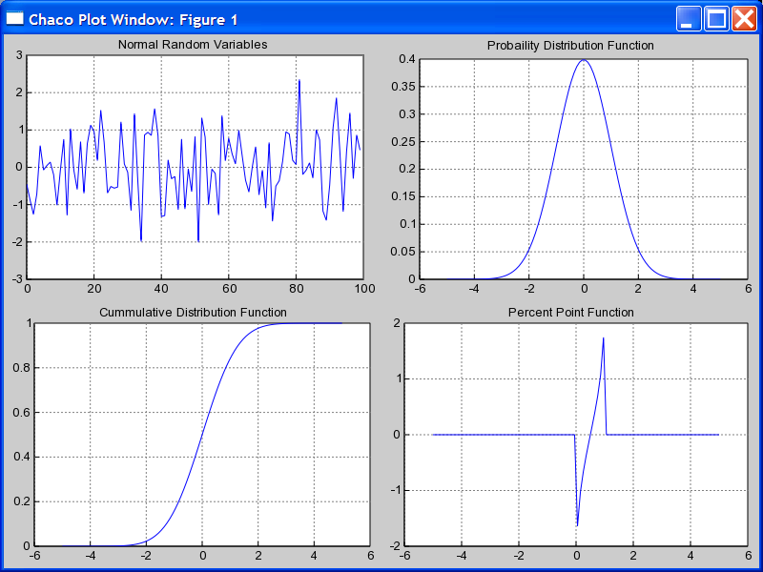
Using stats objects
DISTRIBUTIONS
# Sample normal dist. 100 times.
>>> samp = stats.norm.rvs(size=100)
>>> x = r_[-5:5:100j]
# Calculate probability dist.
>>> pdf = stats.norm.pdf(x)
# Calculate cummulative Dist.
>>> cdf = stats.norm.cdf(x)
# Calculate Percent Point Function
>>> ppf = stats.norm.ppf(x)

Slide 7
Statistics
scipy.stats --- Basic Statistical Calculations on Data
numpy.mean, numpy.std, numpy.var, numpy.cov
stats.skew, stats.kurtosis, stats.moment

Slide 8
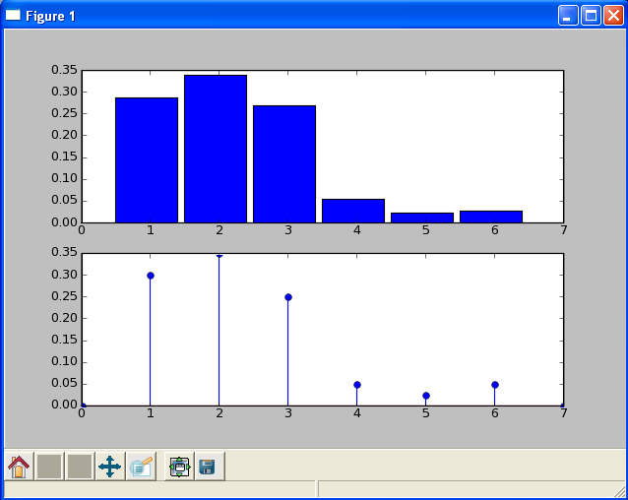
Using stats objects
CREATING NEW DISCRETE DISTRIBUTIONS
# Create a loaded dice.
>>> from scipy.stats import rv_discrete
>>> xk = [1,2,3,4,5,6]
>>> pk = [0.3,0.35,0.25,0.05,
0.025,0.025]
>>> new = rv_discrete(name='loaded',
values=(xk,pk))
# Calculate histogram
>>> samples = new.rvs(size=1000)
>>> bins=linspace(0.5,5.5,6)
>>> subplot(211)
>>> hist(samples,bins=bins,normed=True)
# Calculate pmf
>>> x = range(0,8)
>>> subplot(212)
>>> stem(x,new.pmf(x))

Slide 9
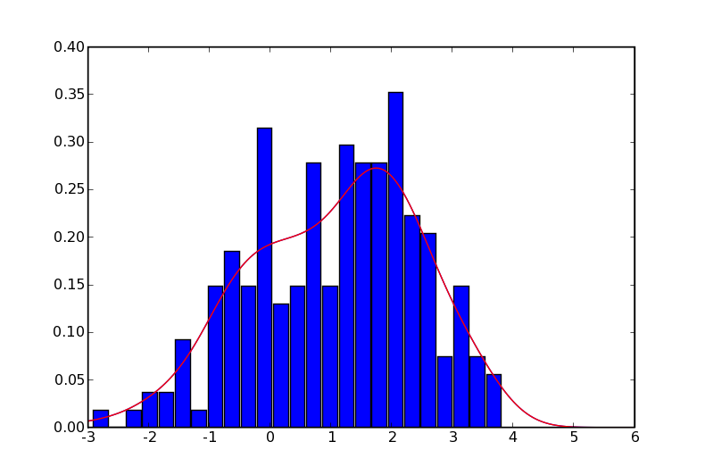
Statistics
Continuous PDF Estimation using Gaussian Kernel Density Estimation
# Sample normal dist. 100 times.
>>> rv1 = stats.norm()
>>> rv2 = stats.norm(2.0,0.8)
>>> samp = r_[rv1.rvs(size=100),
rv2.rvs(size=100)]
# Kernel estimate (smoothed histogram)
>>> apdf = stats.kde.gaussian_kde(samp)
>>> x = linspace(-3,6,200)
>>> plot(x, apdf(x),’r’)
# Histogram
>>> hist(x, bins=25, normed=True)

